Slide 1

King Soopers Fuel Center Management
Created by
Your Name

Slide 2
Entity Relationship Diagram (ERD)
ERD Structure
Components
Data Organization
The ERD depicts the structure of the King Soopers Fuel Center management system, highlighting the interconnected entities and their relationships. It serves as a visual representation of the database design.
The ERD comprises entities such as Customer, Vehicle, Fuel Type, Pump, Transaction, Promotion, and the association table Fuel Points. Each entity plays a vital role in managing the fuel center operations.
The ERD organizes data to ensure efficient management of customer information, vehicle details, fuel types, pump usage, transactions, promotions, and fuel point awards, offering a comprehensive view of the fuel center system.

Slide 3
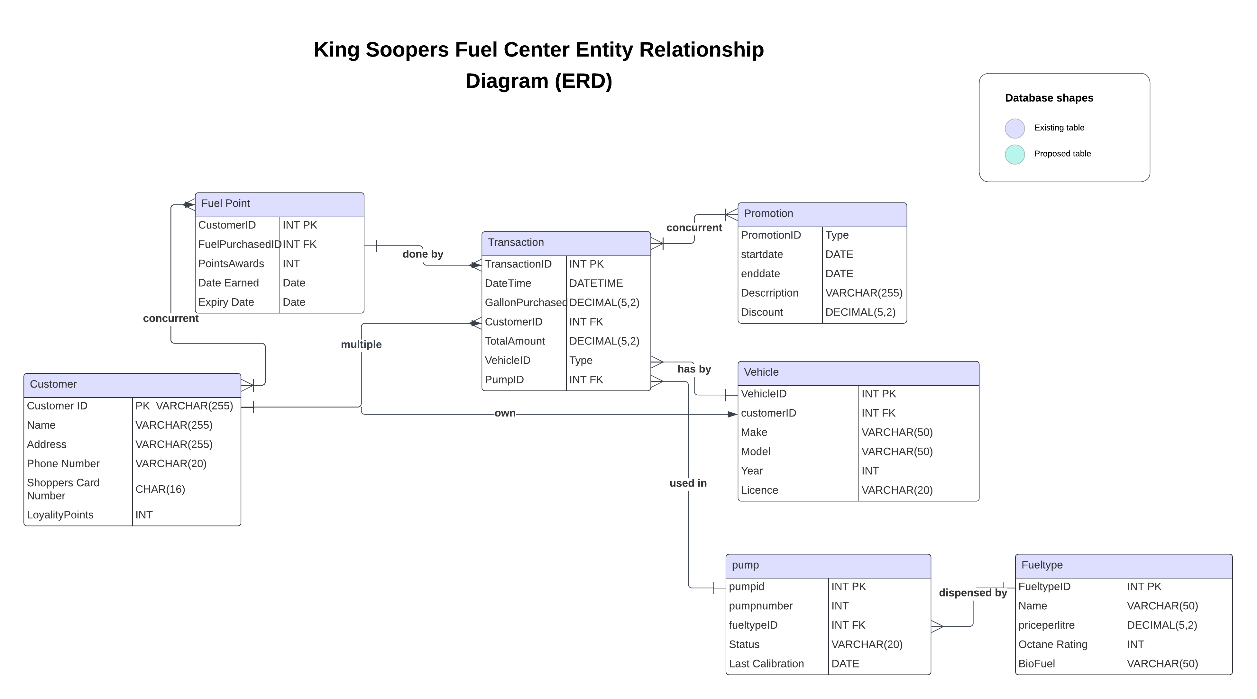

Slide 4
Entities and Attributes
Customer
Vehicle
Fuel Type, Pump, Transaction, Promotion, Fuel Points
The Customer entity encapsulates crucial details including names, addresses, contact information, shopper's card number, loyalty points, and acts as a central component for customer-related operations at the fuel center.
The Vehicle entity contains essential attributes such as make, model, year, license plate number, and associates each vehicle with a customer, facilitating efficient vehicle management within the system.
These entities contribute to the effective management of fuel types, pump operations, transactions, promotions, and the rewarding of fuel points, forming the core framework for fuel center operations.

Slide 5
Entities and Attributes
Customer
Vehicle
Fuel Type
* Attributes:
* CustomerID (VARCHAR(255) - Primary Key)
* Name (VARCHAR(255))
* Address (VARCHAR(255))
* Phone Number (VARCHAR(20))
* Shopper's Card Number (CHAR(16)) - Unique identifier for King Soopers loyalty program
* Loyalty Points (INT)
* Attributes:
* VehicleID (INT - Primary Key)
* Make (VARCHAR(50))
* Model (VARCHAR(50))
* Year (INT)
* License Plate Number (VARCHAR(20))
* CustomerID (FK - INT) - One customer can have many vehicles (references Customer.CustomerID)
* Attributes:
* FuelTypeID (INT - Primary Key)
* Name (VARCHAR(50))
* Price per Liter (DECIMAL(5,2))
*Octane Rating (INT)
*Blend (VARCHAR(50))

Slide 6
Entities and Attributes
Pump
Fuel Points
Transaction
Promotion
* Attributes:
* PumpID (INT - Primary Key)
* Pump Number (INT)
* FuelTypeID (FK - INT) - One pump dispenses one fuel type (references FuelType.FuelTypeID)
Status (VARCHAR(20)):
Last Calibration Date (DATE): Date of the last pump calibration to ensure accurate fuel measurement.
* Attributes:
* CustomerID (FK - INT) - References the customer earning points (references Customer.CustomerID)
* FuelPurchaseID (FK - INT) - References the specific transaction where points were earned (references Transaction.TransactionID)
* Points Awarded (INT)
*Date Earned (DATE):
*Expiration Date (DATE)
* Attributes:(This entity can be included if applicable)
* PromotionID (INT - Primary Key)
* Start Date (DATE)
* End Date (DATE)
* Description (VARCHAR(255)) - e.g., "Earn double fuel points on Wednesdays"
* Discount (DECIMAL(5,2)) - Percentage or fixed amount
* Attributes:
* TransactionID (INT - Primary Key)
* Date and Time (DATETIME)
* CustomerID (FK - INT) - One customer can have many transactions (references Customer.CustomerID)
* VehicleID (FK - INT) - One vehicle can be involved in many transactions (references Vehicle.VehicleID)
* PumpID (FK - INT) - One pump can be used in many transactions (references Pump.PumpID)
* Gallons Purchased (DECIMAL(5,2)) - Adjusted for location
* Total Amount (DECIMAL(10,2))

Slide 7

Relationships
Significance
Entity Relationships
These relationships enable seamless association and interaction between entities, ensuring accurate record-keeping, systematic management, and streamlined operations at the King Soopers Fuel Center.
The ERD depicts several relationships, including one-to-many relationships between Customer and Vehicle, Customer and Transaction, Vehicle and Transaction, Transaction and Pump, and one-to-many relationship between Fuel Type and Pump, essential for operational efficiency.

Slide 8
Relationships
Customer (1) : M (Many) Vehicle: A customer can own many vehicles.
M (Many) Transaction : 1 (One) Customer: A customer can have many transactions. (One-to-Many)
M (Many) Transaction : 1 (One) Vehicle: A vehicle can be involved in many transactions. (One-to-Many)
M (Many) Transaction : 1 (One) Pump: A pump can be used in many transactions. (One-to-Many)
1 (One) Fuel Type : M (Many) Pump: One fuel type can be dispensed from many pumps. (One-to-Many)
Promotion (M) : M (Many) Transaction (Optional): A promotion can apply to many transactions, and a transaction can benefit from multiple promotions running concurrently. (Many-to-Many) - Optional
Customer (M) : M (Many) Fuel Points (Optional): A customer can earn points from many transactions, and a single transaction can award points to one customer. (Many-to-Many captured by Fuel Points table) - Optional

Slide 10

Normalization
Efficiency
Benefits
The normalization of the ERD minimizes redundancy by organizing data logically, preventing inconsistencies, and enhancing data integrity, essential for efficient data storage and retrieval.
This ERD avoids redundancy by separating information. For example, customer loyalty information is stored in the Customer table, and transactions reference the CustomerID and Shopper's Card Number instead of duplicating all customer details in each transaction record.

Slide 11
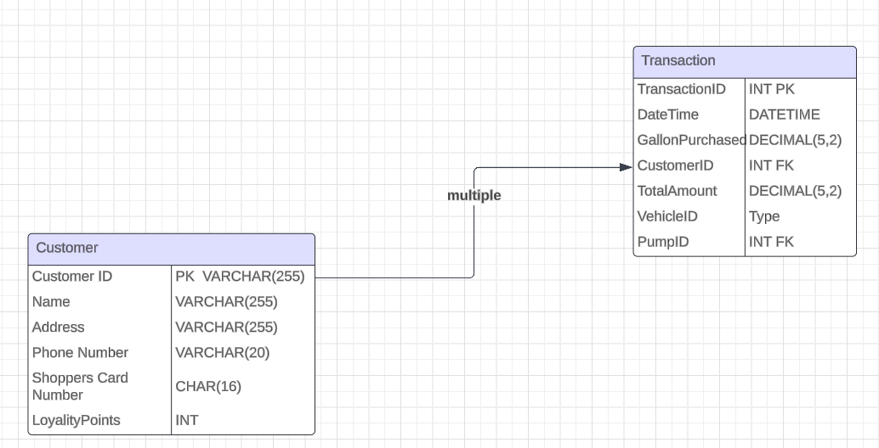
Normalization

Slide 12

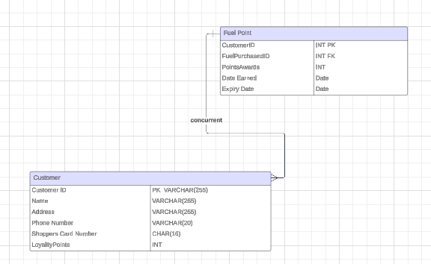
M:N Relationship
Fuel Points Table
The M:N relationship between Customers and Fuel Points is captured through the dedicated Fuel Points table, linking customer transactions to earned fuel points. This design efficiently manages the complex many-to-many relationship.

